Slide 1
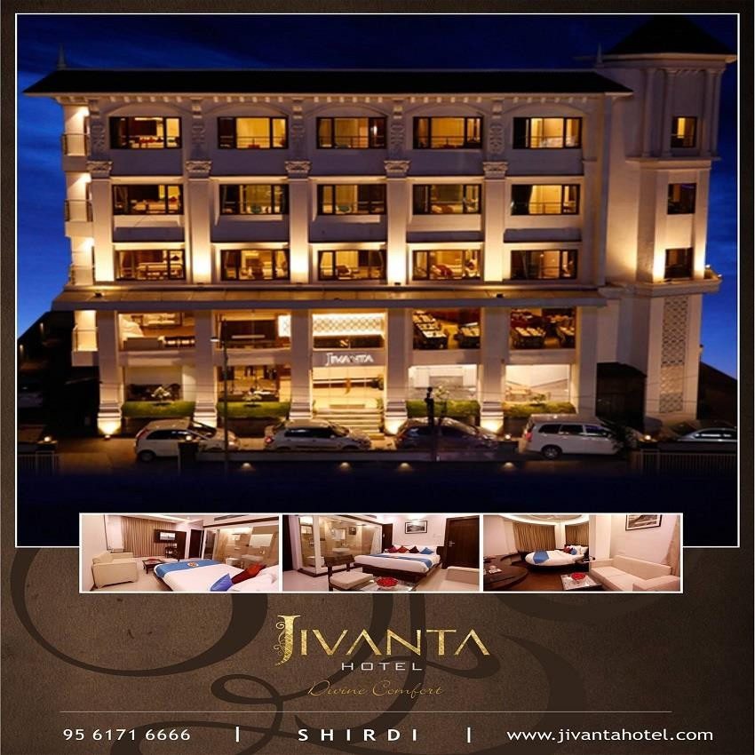
Best experience of stay in a good hotel in Mahabaleshwar
Are you looking for a fabulous, tranquil, and exotic weekend escape that isn't too far from the hustle and bustle of the city? Looking for a luxurious, comfortable, and peaceful stay that is worth experiencing? Jivanta Hotel will provide you with one of the most enjoyable hotel stays in Mahabaleshwar.
Jivanta Hotel is a good hotel in Mahabaleshwar that will fascinate you with its lush green splendor. The resort, which is nestled in the heart of a forest, is a haven for stress relief.
This property is so large that you could easily spend a whole day exploring it and engaging in a variety of activities.

Slide 2
Looking for the best Mahabaleshwar hotels for your upcoming trip? Mahabaleshwar is a small town in the Indian state of Maharashtra. It's found within the Satara district. It is essentially a hill station situated in the steep Sahyadri region for those unfamiliar with the area.
The sites in Mahabaleshwar
Mahabaleshwar, like every other tourist destination, has a number of must-see attractions. The following are some of the must-see sights in the small town:
Venna Lake - This is often considered Mahabaleshwar's most popular tourist attraction. The lake is encircled on all sides by trees and offers a beautiful view.
Mapro Garden- This garden, which is brimming with strawberries, is a popular tourist
destination. It is host to a huge strawberry plantation as well as annual Strawberry Festivals.
Elephant's Head Point - This fascinating area of the mountain displays a striking
resemblance to an elephant's head. It's also one of the best places to have a picnic.
Lingamala Falls- This waterfall is quite stunning. It's located in the heart of Mother Nature
and is quite calming to the eyes, making you feel as if you're one with the natural environment.
A number of historical sites, Mahabaleshwar has including the following:
Pratapgad
The Lord Mahabaleshwar Temple
Rajapuri Caves
There are a number of good hotels in Mahabaleshwar where you may enjoy a pleasant stay-in. Jivanta Hotel is one of Mahabaleshwar's Best Hotels, offering the best hospitality possible. Book now at http://jivantahotel.com/

